Slide 1
Routing Techniques in Wireless Sensor Networks: A Survey
J. Al-Karaki, A. E. Kamal
A Survey on Routing Protocols for Wireless Sensor Networks
K. Akkaya, M. Younis

Slide 2
Routing challenges and design issues
Node deployment
  Manual deployment
    Sensors are manually deployed
    Data is routed through predetermined path
  Random deployment
    Optimal clustering is necessary to allow connectivity & energy-efficiency
    Multi-hop routing

Slide 3
Routing challenges and design issues
Data routing methods
  Application-specific
  Time-driven: Periodic monitoring
  Event-driven: Respond to sudden changes
  Query-driven: Respond to queries
  Hybrid

Slide 4
Routing challenges and design issues
Node/link heterogeneity
  Homogeneous sensors
  Heterogeneous nodes with different roles & capabilities
    Diverse modalities
    If cluster heads may have more energy & computational capability, they take care of transmissions to the base station (BS)

Slide 5
Routing challenges and design issues
Fault tolerance
  Some sensors may fail due to lack of power, physical damage, or environmental interference
  Adjust transmission power, change sensing rate, reroute packets through regions with more power

Slide 6
Routing challenges and design issues
Network dynamics
  Mobile nodes
  Mobile events, e.g., target tracking
  If WSN is to sense a fixed event, networks can work in a reactive manner
    A lot of applications require periodic reporting

Slide 7
Routing challenges and design issues
Transmission media
  Wireless channel
  Limited bandwidth: 1 – 100Kbps
  MAC
    Contention-free, e.g., TDMA or CDMA
    Contention-based, e.g., CSMA, MACA, or 802.11

Slide 8
Routing challenges and design issues
Connectivity
  High density → high connectivity
  Some sensors may die after consuming their battery power
  Connectivity depends on possibly random deployment

Slide 9
Routing challenges and design issues
Coverage
  An individual sensor’s view is limited
  Area coverage is an important design factor
Data aggregation
Quality of Service
  Bounded delay
  Energy efficiency for longer network lifetime

Slide 10
Routing Protocols in WSNs
I. Flat
II. Hierarchical
III. Location-based
IV. QoS-based

Slide 11
I. Flat routing

Slide 12
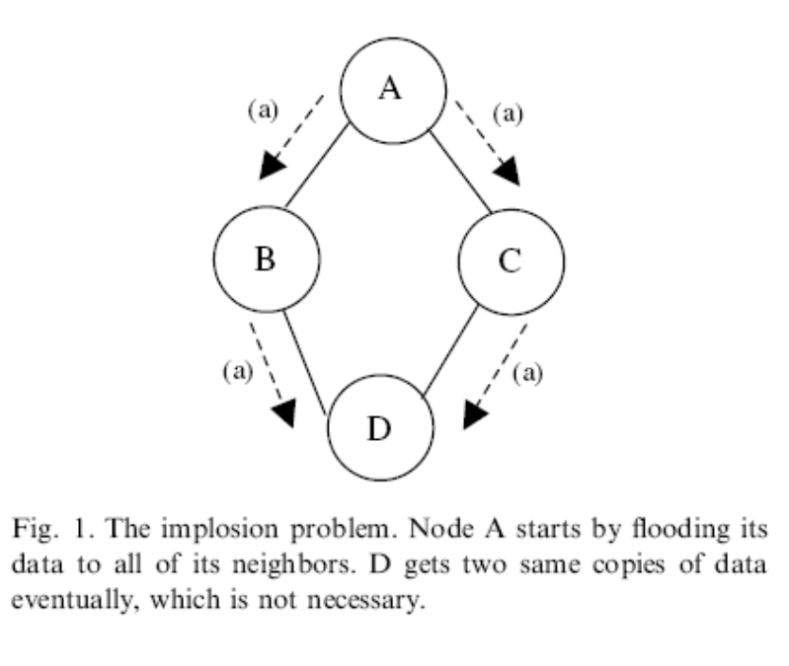
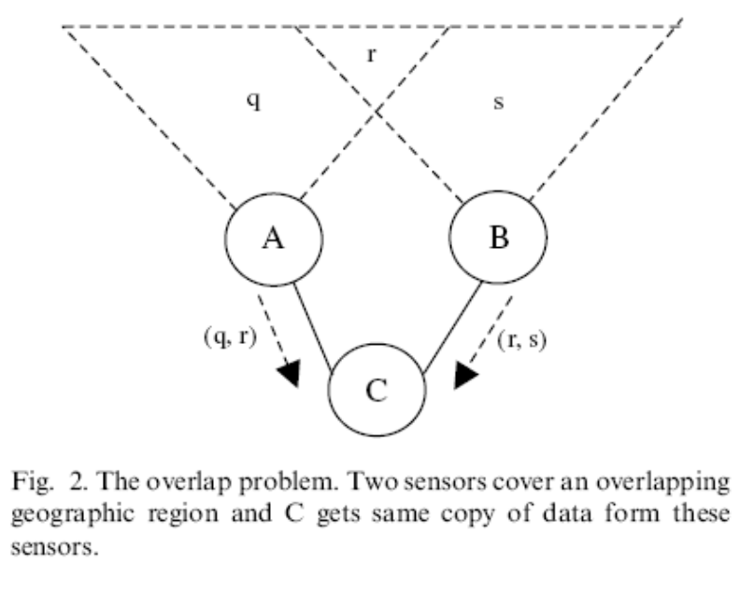
Flooding
  Too much waste
  Implosion & Overlap
  Use in a limited scope, if necessary
Data-centric routing
  No globally unique ID
  Naming based on data attributes
  SPIN, Directed diffusion, ...

Slide 13
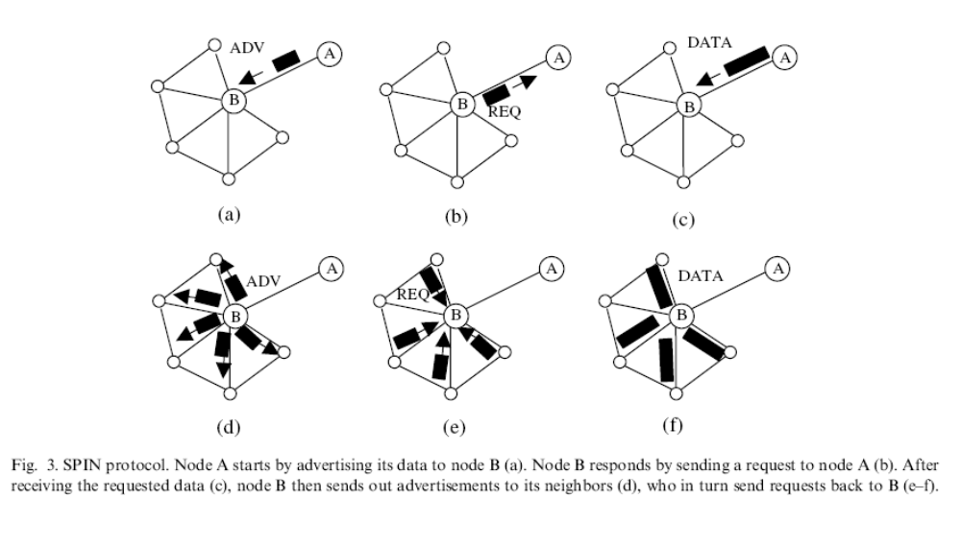
SPIN (Sensor Protocols for Information via Negotiation)

Slide 14
SPIN
Pros
  Each node only needs to know its one-hop neighbors
  Significantly reduce energy consumption compared to flooding
Cons
  Data advertisement cannot guarantee the delivery of data
    If the node interested in the data are far from the source, data will not be delivered
    Not good for applications requiring reliable data delivery, e.g., intrusion detection

Slide 15
Direct Diffusion: Motivation
Properties of Sensor Networks
  Data centric
  No central authority
  Resource constrained
  Nodes are tied to physical locations
  Nodes may not know the topology
  Nodes are generally stationary
How can we get data from the sensors?

Slide 16
Directed Diffusion: Main Features
Data centric
  Individual nodes are unimportant
Request driven
  Sinks place requests as interests
  Sources satisfying the interest can be found
  Intermediate nodes route data toward sinks
Localized repair and reinforcement
Multi-path delivery for multiple sources, sinks, and queries

Slide 17
Directed Diffusion: Motivating Example
Sensor nodes are monitoring animals
Users are interested in receiving data for all 4-legged creatures seen in a rectangle
Users specify the data rate

Slide 18
Directed Diffusion: Interest and Event Naming
Query/interest:
  Type=four-legged animal
  Interval=20ms (event data rate)
  Duration=10 seconds (time to cache)
  Rect=[-100, 100, 200, 400]
Reply:
  Type=four-legged animal
  Instance = elephant
  Location = [125, 220]
  Intensity = 0.6
  Confidence = 0.85
  Timestamp = 01:20:40
Attribute-Value pairs, no advanced naming scheme

Slide 19


Directed Diffusion: Interest Propagation
Flood interest
Constrained or Directional flooding based on location is possible
Directional propagation based on previously cached data
Source
Gradient
Interest
Sink

Slide 20
Directed Diffusion: Data Propagation
Multipath routing
  Consider each gradient’s link quality
Source
Gradient
Data
Sink

Slide 21
Directed Diffusion: Reinforcement
Reinforce one of the neighbor after receiving initial data.
  Neighbor who consistently performs better than others
  Neighbor from whom most events received
Source
Gradient
Data
Reinforcement
Sink

Slide 22
Directed Diffusion: Negative Reinforcement
Explicitly degrade the path by re-sending interest with lower data rate.
Time out: Without periodic reinforcement, a gradient will be torn down
Source
Gradient
Data
Reinforcement
Sink

Slide 23
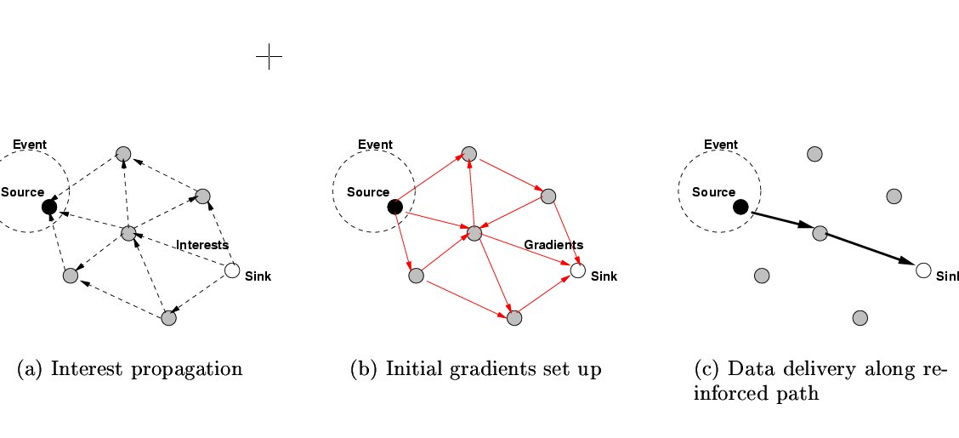
Directed Diffusion: Summary of the protocol

Slide 24
Directed Diffusion: Pros & Cons
Different from SPIN in terms of on-demand data querying mechanism
  Sink floods interests only if necessary
    A lot of energy savings
  In SPIN, sensors advertise the availability of data
Pros
  Data centric: All communications are neighbor to neighbor with no need for a node addressing mechanism
  Each node can do aggregation & caching
Cons
  On-demand, query-driven: Inappropriate for applications requiring continuous data delivery, e.g., environmental monitoring
  Attribute-based naming scheme is application dependent
    For each application it should be defined a priori
    Extra processing overhead at sensor nodes

Slide 25
Extension of Directed Diffusion
One-phase pull
  Propagate interest
  A receiving node pick the link that delivered the interest first
  Assumes the link bidirectionality
Push diffusion
  Sink does not flood interest
  Source detecting events disseminate exploratory data across the network
  Sink having corresponding interest reinforces one of the paths

Slide 26
Rumor Routing
Variation of directed diffusion
  Don’t flood interests (or queries)
  Flood events when the number of events is small but the number of queries large
  Route the query to the nodes that have observed a particular event
  Long-lived packets, called agents, flood events through the network
  When a node detects an event, it adds the event to its events table, and generates an agent
  Agents travel the network to propagate info about local events
    An agent is associated with TTL (Time-To-Live)

Slide 27
Rumor Routing
  When a node generates a query, a node knowing the route to a corresponding event can respond by looking up its events table
    No need for query flooding ☺
    Only one path between the source and sink ☺ ☹
    Rumor routing works well only when the number of events is small ☹
    Cost of maintaining a large number of agents and large event tables will be prohibitive ☹
    Heuristic for defining the route of an event agent highly affects the performance of next-hop selection ☹

Slide 28
MCFA (Minimum Cost Forwarding Algorithm)
Assume the direction of routing is always known, i.e., toward the fixed base station (BS)
No need for a node to have a unique ID or routing table
Each node maintains the least cost estimate from itself to BS
Broadcast a message to neighbors
A neighbor checks if it’s on the least cost path btwn the source and BS
If so, it re-broadcasts the message to its neighbors
Repeat until BS is reached

Slide 29
MCFA
Each node has to know the least cost path estimate to BS
  BS broadcasts a message with cost set to 0
  Every node initially sets its cost to BS to ∞
  When a node receives the msg from BS, it checks if the estimate in the packet + 1 < the node’s current estimate to BS
    If yes, the current estimate & estimate in the msg are updated and resent
    Else, delete the msg; Do nothing
  A node far from BS may receive several msg’s → A node will not send the updated msg until a * lc where a is a constant & lc is the link cost
Works well for fixed topologies ☺ ☹
Sensors are assumed to know what they have to look for
  ☺ or ☹?

Slide 30
Gradient-Based Routing (GBR)
Variation of directed diffusion
Each node memorizes the number of hops when the interest is diffused
Each node computes its height, i.e., the minimum number of hops to BS
Difference btwn a node’s height & its neighbor’s is the gradient on the link
Forward a packet on a link with the largest gradient
Data aggregation
  When multiple paths pass through a node, the node can combine data
Traffic spreading
  Uniformly divide traffic over the network to increase network lifetime
    Stochastic scheme: Randomly pick a gradient when two or more next hops have the same gradient
    Energy-based scheme: A node increases its height when its energy drops below a certain threshold
    Stream-based scheme: New streams are not routed through nodes that are part of the path for other streams
Outperforms directed diffusion in terms of total energy

Slide 31
COUGAR & TinyDB
View a WSN as a distributed database
Use declarative queries to abstract query processing from the network layer—network layer independent
Perform in-network data aggregation
Drawbacks
  Extra overhead & energy consumption due to the extra query layer
  Synchronization is required for data aggregations
  Leader nodes should be dynamically maintained to prevent them from being hotspots

Slide 32
ACQUIRE
View a WSN as a distributed DB
Complex queries can be divided into subqueries
BS sends a query
Each node tries to answer the query by using precached info and forwards the query to another node
If the cached info is not fresh, the nodes gather info from their neighbors within a lookahead of d hops
Once the query is resolved completely, it is sent back to BS via the reverse path or shortest path
ACQUIRE can deal with complex queries by allowing many nodes send to send responses
  Directed diffusion cannot handle complex queries due to too much flooding
  ACQUIRE can adjust d for efficient query processing
  If d = network diameter, ACQUIRE becomes similar to flooding
  In contrast, a query has to travel more if d is too small
  Provides mathematical modeling to find an optimal value of d for a grid of sensors, but no experiments performed

Slide 33
II. Hierarchical Routing

Slide 34
LEACH (Low Energy Clustering Hierarchy)
Cluster-based protocol
Each node randomly decides to become a cluster heads (CH)
CH chooses the code to be used in its cluster
  CDMA between clusters
CH broadcasts Adv; Each node decides to which cluster it belongs based on the received signal strength of Adv
CH creates a xmission schedule for TDMA in the cluster
Nodes can sleep when its not their turn to xmit
CH compresses data received from the nodes in the cluster and sends the aggregated data to BS
CH is rotated randomly

Slide 35
LEACH
  Pros
    Distributed, no global knowledge required
    Energy saving due to aggregation by CHs
  Shortcomings
    LEACH assumes all nodes can transmit with enough power to reach BS if necessary (e.g., elected as CHs)
    Each node should support both TDMA & CDMA
  Extension of LEACH [5]
    High level negotiation, similar to SPIN
    Only data providing new info is transmitted to BS

Slide 36
Comparison between SPIN, LEACH & Directed Diffusion
 | SPIN | LEACH | Directed Diffusion
Optimal Route | No | No | Yes
Network Lifetime | Good | Very good | Good
Resource Awareness | Yes | Yes | Yes
Use of meta-data | Yes | No | Yes

Slide 37
TEEN (Threshold sensitive Energy Efficient Network protocol)
Reactive, event-driven protocol for time-critical applications
  A node senses the environment continuously, but turns radio on and xmit only if the sensor value changes drastically
  No periodic xmission
    Don’t wait until the next period to xmit critical data
    Save energy if data is not critical
CH sends its members a hard & a soft threshold
  Hard threshold: A member only sends data to CH only if data values are in the range of interest
  Soft threshold: A member only sends data if its value changes by at least the soft threshold
  Every node in a cluster takes turns to become the CH for a time interval called cluster period
Hierarchical clustering

Slide 38
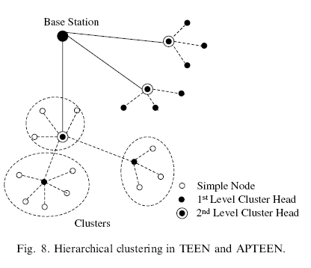
Multi-level hierarchical clustering in TEEN & APTEEN

Slide 39
TEEN
Good for time-critical applications ☺
Energy saving ☺
  Less energy than proactive approaches
  Soft threshold can be adapted
  Hard threshold could also be adapted depending on applications
Inappropriate for periodic monitoring, e.g., habitat monitoring ☹
Ambiguity between packet loss and unimportant data (indicating no drastic change) ☹

Slide 40
APTEEN (Adaptive Threshold sensitive Energy Efficient Network protocol)
Extends TEEN to support both periodic sensing & reacting to time critical events
Unlike TEEN, a node must sample & transmit a data if it has not sent data for a time period equal to CT (count time) specified by CH
Compared to LEACH, TEEN & APTEEN consumes less energy (TEEN consumes the least)
  Network lifetime: TEEN ≥ APTEEN ≥ LEACH
Drawbacks of TEEN & APTEEN
  Overhead & complexity of forming clusters in multiple levels and implementing threshold-based functions

Slide 41
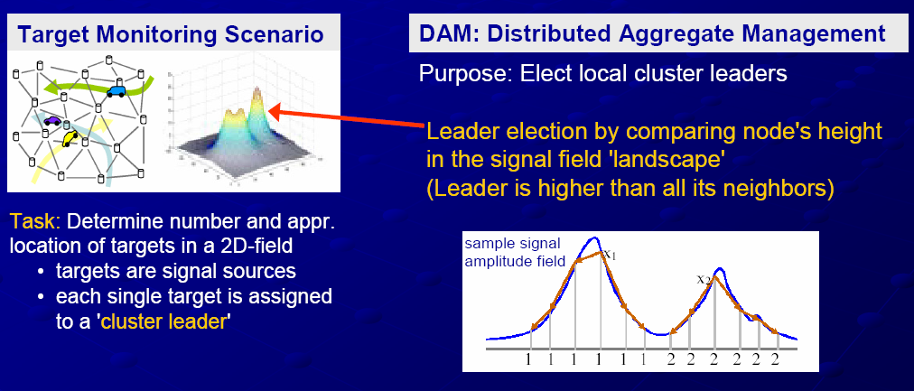
Sensor aggregate routing
Sensor aggregate: a set of nodes satisfying a grouping predicate
Mainly designed for target tracking
Source: M. Handy at University of Rostock

Slide 42
TTDD (Two Tier Data Dissemination)
Data dissemination to mobile sinks
Two-tier query & data forwarding
Objectives
  Source proactively builds a grid structure to support data availability for mobile sinks
    Mobility pattern is unknown a priori
  Localize impacts of sink mobility on data forwarding
  Only a small set of sensor nodes maintain forwarding state

Slide 43
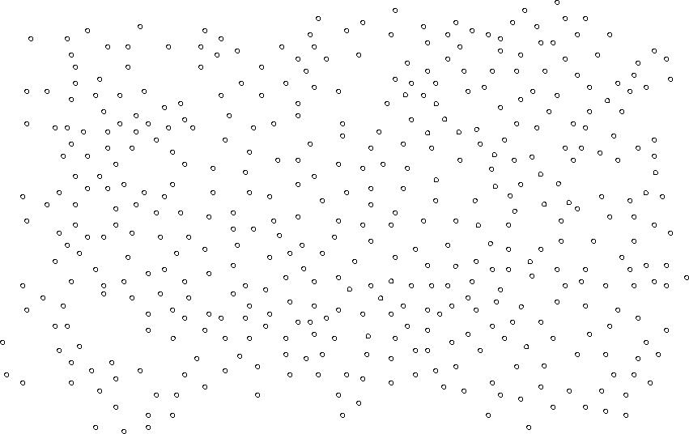
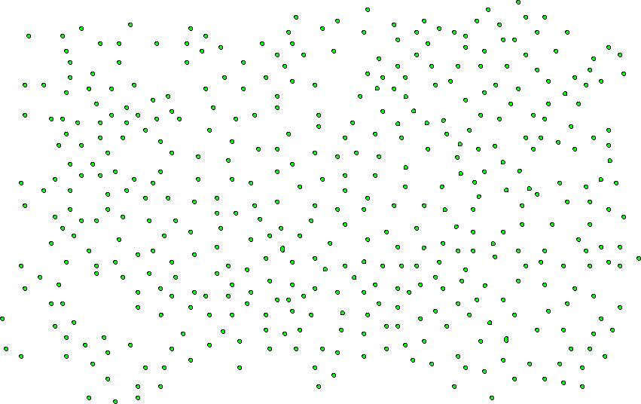
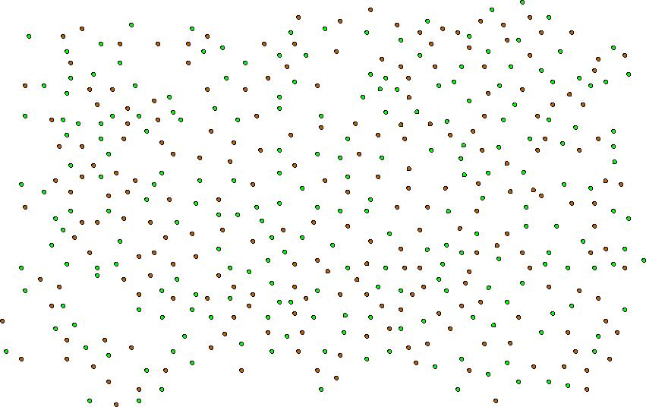



TTDD: Sensor Network Model
Sink
Stimulus
Source
Sink
Source: TTDD at Mobicom ‘02

Slide 44
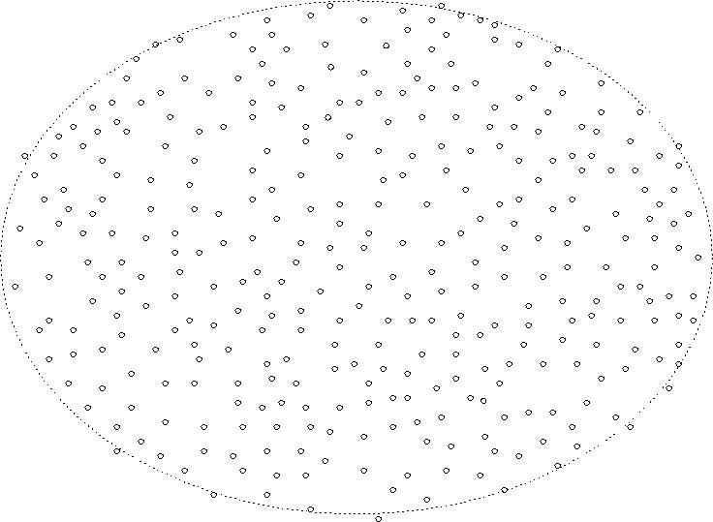
TTDD Basics
Dissemination Node
Data Announcement
Source
Data
Sink
Immediate
Dissemination
Node
Query
Source: TTDD at Mobicom ‘02

Slide 45
TTDD Mobile Sinks
Dissemination Node
Data Announcement
Trajectory
Forwarding
Source
Immediate
Dissemination
Node
Data
Sink
Immediate
Dissemination
Node
Trajectory
Forwarding
Source: TTDD at Mobicom ‘02

Slide 46
TTDD Multiple Mobile Sinks
Dissemination Node
Data Announcement
Trajectory
Forwarding
Source
Immediate
Dissemination
Node
Data
Source
Source: TTDD at Mobicom ‘02

Slide 47
Grid Maintenance
Dissemination Node
Source
X
Immediate
Dissemination
Node
Data
Source: TTDD at Mobicom ‘02

Slide 48
III. Location-based routing protocols

Slide 49
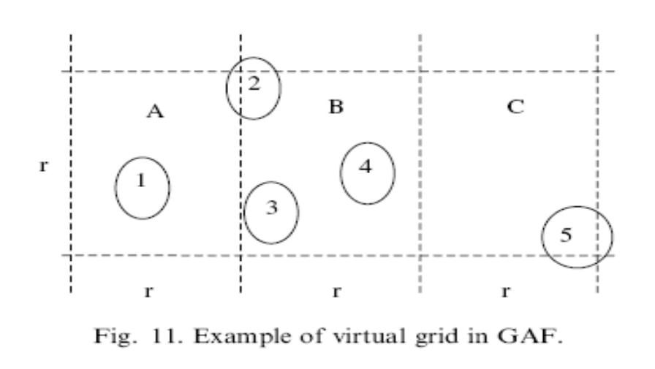
GAF (Geographic Adaptive Fidelity)
Energy-aware location-based protocol mainly designed for MANET
Each node knows its location via GPS
  Associate itself with a point in the virtual grid
  Nodes associated with the same point on the grid are considered equivalent in terms of the cost of packet routing
  Node 1 can reach any of nodes 2, 3 & 4 → 2,3, 4 are equivalent; Any of the two can sleep without affecting routing fidelity

Slide 50
GAF
Three states
  Discovery: Determine neighbors in a grid
  Active
  Sleep
Each node in the grid estimates its time of leaving the grid and sends it to its neighbors
  The sleeping neighbors adjust their sleeping time to keep the routing fidelity

Slide 51
GEAR (Geographic and Energy Aware Routing)
Restrict the number of interest floods in directed diffusion
  Consider only a certain region of the network rather than flooding the entire network
Each node keeps an estimated cost & a learning cost of reaching the sink through its neighbors
Estimated cost = f(residual energy, distance to the destination)
Learned cost is propagated one hop back every time a packet reaches the sink
  Route setup for the next packet can be adjusted

Slide 52
GEAR
Phase 1: Forwarding packets towards the region
  Forward a packet to the neighbor minimizing the cost function f
    Forward data to the neighbor which is closest to the sink and has the highest level of remaining energy
  If all neighbors are further than itself, there is a hole → Pick one of the neighbors based on the learned cost

Slide 53
GEAR
Phase 2: Forwarding the packet within the target region
  Apply either recursive forwarding
    Divide the region into four subareas and send four copies of the packet
    Repeat this until regions with only one node are left
  Alternatively apply restricted flooding
    Apply when the node density is low
GEAR successfully delivers significantly more packets than GPSR (Greedy Perimeter Stateless Routing)
  GPSR will be covered in detail in another class

Slide 54
IV. QoS-aware routing

Slide 55
SAR (Sequential Assignment Routing)
Table-driven multi-path approach to achieve energy efficiency & fault tolerance
Creates trees rooted at one hop neighbors of the sink -> Form multiple paths from sink to sensors
  QoS metrics, energy resource, priority level of each packet
Local Failure Recovery
Select one of the paths according to the energy resources and QoS on the path
High overhead to maintain tables and states at each sensor

Slide 56
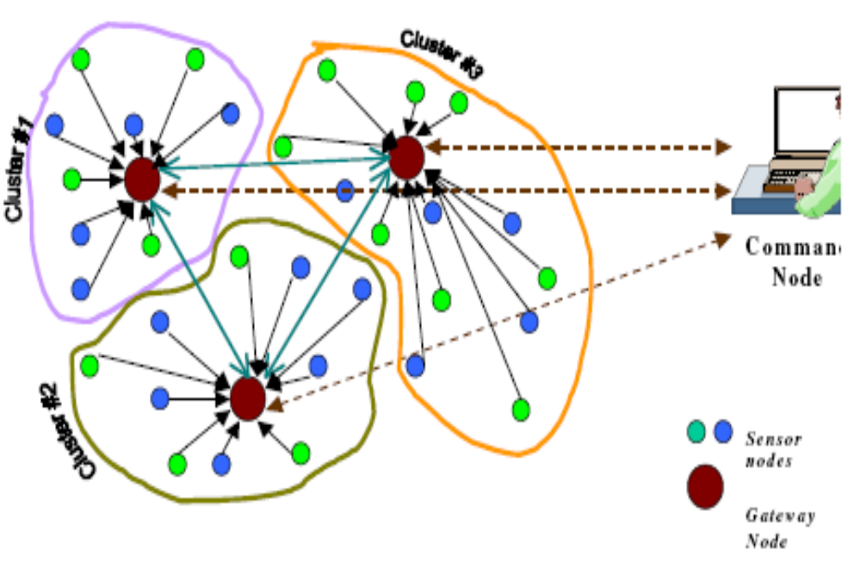
Energy Aware QoS Routing Protocol
Basic settings
  Base station
  Gateways can communicate with each other
  Sensor nodes in a cluster can only be accessed by the gateway managing the cluster
  Focus on QoS routing in one cluster
  Real-time & non-real-time traffic exist
    Support timing constraints for RT
    Improve throughput of non-RT traffic

Slide 57
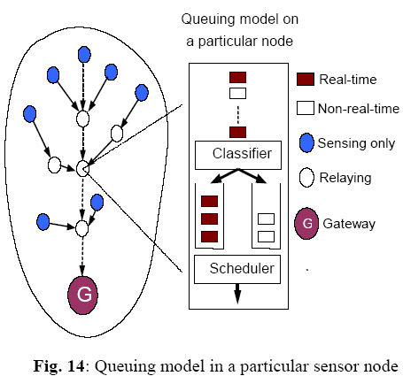
Energy Aware QoS Routing Protocol
Finds least cost and energy efficient paths that meet the end-to-end delay during connection
  Link cost = f(energy reserve, transmission energy, error rate) of nodes
Class-based queuing model used to support best-effort and real-time traffic generated by imaging sensors

Slide 58
Energy Aware QoS Routing Protocol
Support bandwidth ratio r between real-time and best-effort traffics
  Properly adjust r to support end-to-end delay without severely starving best-effort traffic
Use extended Dijkstra’s algorithm to list an ascending set of least cost paths
A gateway checks if E2E QoS can be met
  Estimates E2E delay = E2E queuing delay + E2E propagation delay
  Only allows to establish a real-time connection if E2E delay ≤ E2E Deadline
  Also, tries to find which r value maximizes the throughput of non-RT traffic

Slide 59
Energy Aware QoS Routing Protocol
Drawbacks
  Transmission time is not considered to estimate E2E delay
    Usually, transmission delay >> propagation delay
  Assumes more powerful gateways
    All communications are through gateways
    Gateways have to find paths and r to support QoS requirements

Slide 60
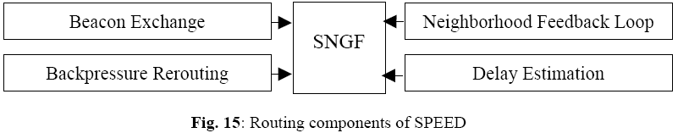
SPEED
Each node maintains info about its neighbors and uses greedy geographic forwarding to find the paths
Tries to ensure a certain speed for each packet in the network
Congestion avoidance
Flat routing – Does not assume more powerful gateways or cluster heads
To be discussed in detail in another class

Slide 61
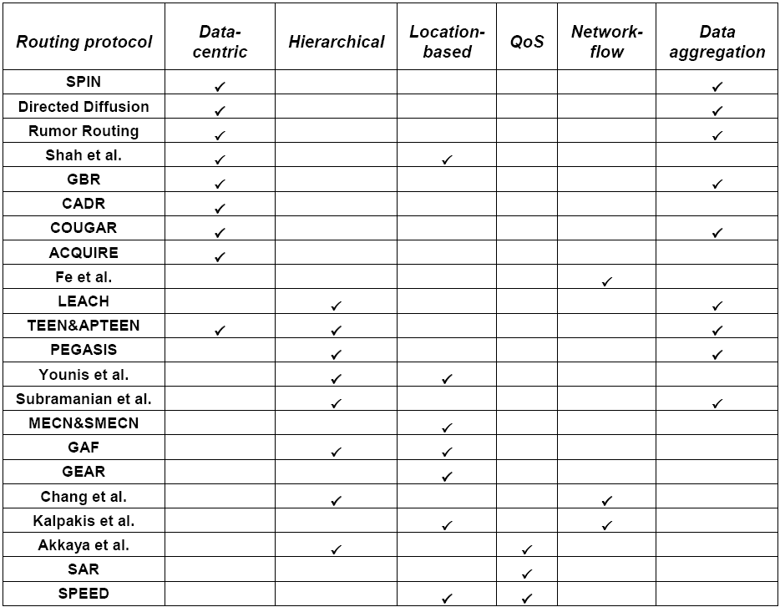
Summary

Slide 62

Questions?

